Slide 1
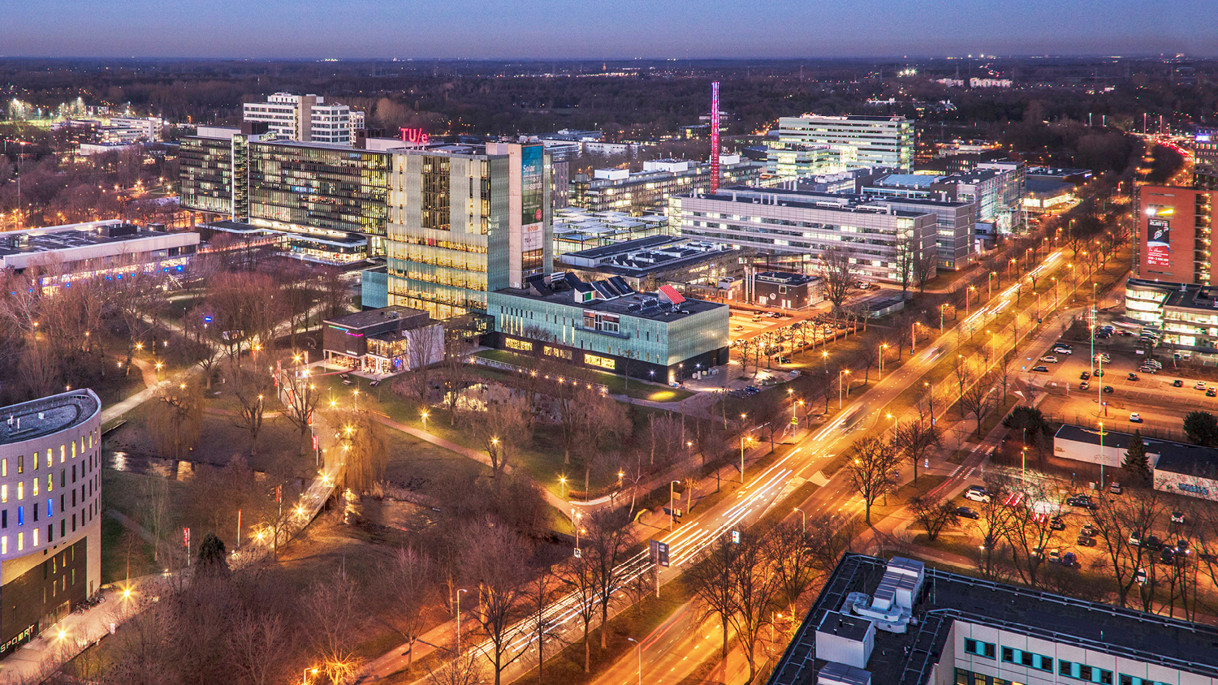
MSc Summer School on Energy Technology (MSSSET)
2021: Energy transition – the path towards net zero
08/03/2021
Maja Ruecker (m.rucker@tue.nl)
Mechanical Engineering, Energy Technology

Slide 2


Energy transition –
the path towards net zero
International MSc summer school 2021
Eindhoven University of Technology & Technical University of Denmark
The continuous growth in energy demands is putting ever more stress on climate and environment. In line with the IPCC, we work on the target of net zero CO₂-emissions by 2050. This goal cannot be achieved with the new zero emission technologies emerging alone but needs to be accompanied by mitigation strategies from energy saving to carbon capture utilization and storage technologies developed and implemented at an international level.
In this course, you will get the opportunity to tackle the
Energy Transition Challenge with your own ideas in an international setting!
You will join lectures by senior researchers within this field from across the world to gain insights into the newest developments in Energy Technology. In a supervised challenge-based learning setting with fellow MSc students from abroad, you will get the opportunity build upon these insights by developing your own ideas, test those and plan the implementation. For the duration of your project you will need to coordinate and communicating with your international project partners online, as it happens in many international projects on Energy Technology. Afterwards, you will get the chance to visit them in their home institute to exchange your experience and to showcase your results.

Slide 3
Proposal
  Is CBL for MSc students in a combined summer school with PhD students feasible and adequate to prepare them for their future roles?
  In the domain of sustainable energy technology, most projects require a quick digest of the newest research development, cross-disciplinary, and multinational communication. The proposed educational project includes all these aspects, but careful consideration needs to be placed into the design and detailed execution to facilitate for the students the development of the necessary skills.
  Focus:
  Balancing and integrating individual (deep) learning and team-based learning in a blended CBL course for the MSc level in an interdisciplinary context
  Coaching strategies research-based challenges
  Cross-country communication
  + international course management

Slide 4
Evaluation
  Student evaluation (feedback session) 1h discussion in groups
  Student evaluation (online) 55% response of 16 students
  Teachers feedback (during and after the session)
Explanation of scores and grades
 | Scale 1-5 | Scale 1-10 | Level/ workload
Insufficient | 1.0 – 2.9 | 1.0 – 5.4 | <2.5 and >3.5
Below average | 3.0 – 3.2 | 5.5 – 5.9 | 2.5 – 2.6 and 3.4 – 3.5
Average | 3.3 – 3.9 | 6.0 – 7.9 | 2.7 – 2.9 and 3.1 – 3.3
Excellent | 4.0 – 5.0 | 8.0 – 10 | 3.0

Slide 5
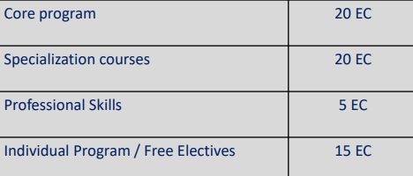

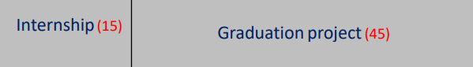
Course design – Embedding ME
e.g. core course:
4EM70 - Sustainable Energy Sources
next to various courses building foundation for engineering
including engineering for the energy sector
Year 1
various specialization courses addressing engineering including engineering for the energy sector
Year 2
How relevant was this project for your study program? | 4.6 (0.5)
Did you have sufficient prior knowledge and/or skills to follow this project? | Yes: 88.9%

Slide 6
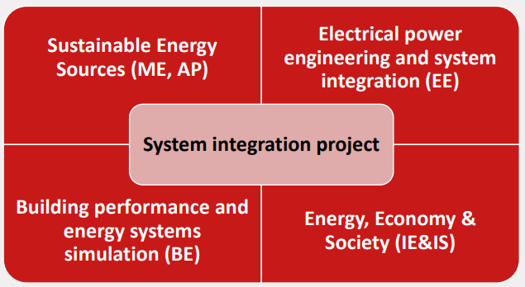
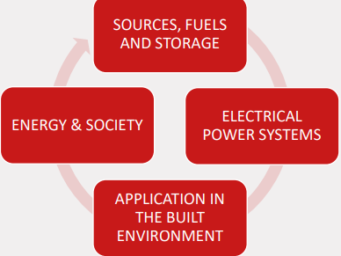
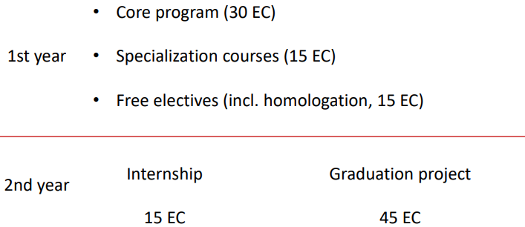
Course design – Embedding SET
How relevant was this project for your study program? | 4.6 (0.5)
Did you have sufficient prior knowledge and/or skills to follow this project? | Yes: 88.9%

Slide 7
Course design – constructive alignment
Teaching
methods
Learning
goals
Assessment
On a scale of 1-10, how would you rate the alignment between learning objectives – teaching methods and assessment? | 8.0 (1.1)
The educational setup (e.g., structure, content, teaching/learning methods, level, and coherence) worked well and was suitable for this project. | 3.9 (0.8)

Slide 8
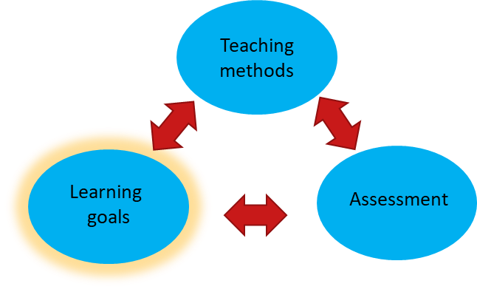
Course design – learning goals
LG 1 | Reflect and apply the most recent developments in energy technology research (year specific)
LG 2 | Plan, execute and communicate results of international projects on energy technology
LG 3 | Build/Use computational tools and databases to draw conclusions regarding the applicability of existing and new solutions to problems outlined (year specific) within energy technology.
LG 4 | Use individual knowledge and expertise in an interdisciplinary and international team to develop an innovative, practical and scientifically sound solution to a current challenge in the field of energy technology (year specific)

Slide 9
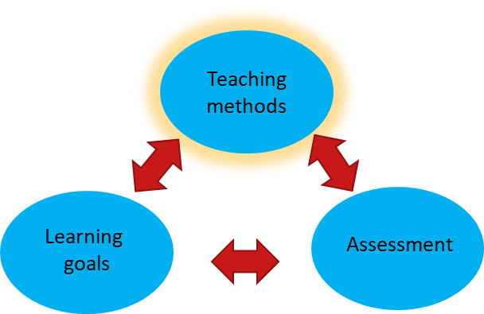
Course design – teaching method
Soft skill training (international communication, reflection, group excersises, escape room) | LG2
Lectures | LG1, LG3
CBL-project | LG2, LG3, LG4

Slide 10
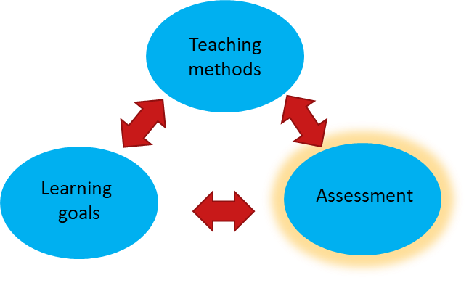
Course design – assessment
Assessment 1: Technical quizzes 20 %of the final grade – LG1
Assessment 2: Management reflection report 20% of the final grade – LG2
Assessment 3: CBL-project presentation 50% of the final grade –
LG1 (10%), LG3 (55%), LG4 (35%)
Assessment 4: Lay summary video 10% of the final grade –
LG2 (50%), LG3 (25%), LG4 (25%)

Slide 11
Course design – assessment
Assessment as a whole
The assessment as a whole was appropriate (e.g. methods used, relevance and clarity of the assignment). | 4.4 (0.5)
The assessment criteria were clear. | 4.6 (0.5)
Assessment (interim test): group work II lay summary video
The interim test provided sufficient feedback to improve my work by the end of the project. | 4.0 (1.1)
The assessment component (interim test) was clear, relevant and representative. | 4.4 (0.9)
Assessment (interim test): individual reflection reports
The interim test provided sufficient feedback to improve my work by the end of the project. | 3.5 (0.9)
The assessment component (interim test) was clear, relevant and representative. | 3.9 (1.2)
Assessment (interim test): quiz (4x)
The interim test provided sufficient feedback to improve my work by the end of the project. | 3.8 (1.6)
The assessment component (interim test) was clear, relevant and representative. | 4.1 (1.5)
Assessment (Final Test): Group work I Presentation
This assessment component (final test) was clear, relevant and representative | 5.0 (0.0)
Do you consider technical quizzes as an appropriate addition for assessment of the learning objectives of the course? | Yes: 66.7%
Do you consider reflection report as an appropriate addition for assessment of the learning objectives of this course? | Yes: 62.5%
Additional comments | have exercises on lectures A lot of different assignments → may go at expense of attending lectures (because of time constraint) Video is a bit of a time waste: the audience for which it is intended is not going to watch it and is a lot of work. The presentation is very short, so it is quite close to your video (you do not have much time to go in to more detail). The video was a good complementation. I have noticed that such requests are often made e.g. in science communication. Its good to get to know how to do it. It was less than a day of work

Slide 12
Course design – assessment
Grade distributions
challenge:
correlating international grading systems
dutch
danish
10 (Outstanding)
9 (Very good)
8 (Good)
7 (More than satisfactory)
6 (Satisfactory)
5 (Almost satisfactory)
4 (Unsatisfactory)
3 (Very unsatisfactory)
2 (Poor)
1 (Very poor)
12 (Outstanding)
10 (Very good)
7 (Good)
4 (fair)
2 (adequate)
0 (inadequate)
-3 (unacceptable)
The meaning of outstanding/very good/good …
Is different from country to country

Slide 13
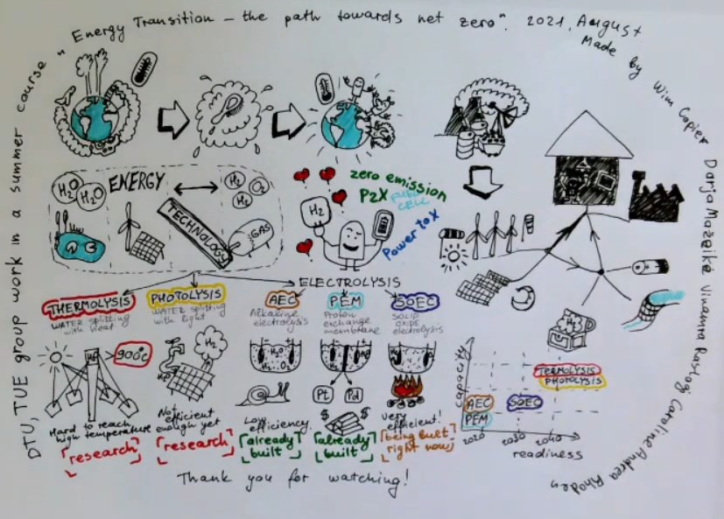
Course design – assessment
Did you consider the lay summary video as an appropriate addition for assessment of the learning objectives of the course? | Yes: 88.9%

Slide 14
Execution
Dates: 16th August – 5th September 2021
Time | Monday | Tuesday | Wednesday | Thurday | Friday
8-9
9-10
10-11
11-12
12-13
13-14
14-15
15-16
16-17
17-18
18-19
19-20
Time | Monday | Tuesday | Wednesday | Thurday | Friday
8-9
9-10
10-11
11-12
12-13
13-14
14-15
15-16
16-17
17-18
18-19
19-20
Kick-off
programme
lectures
(online)
project-
planning
interim
feedback
feedback
project-
execution
Time | Monday | Tuesday | Wednesday | Thurday | Friday
8-9
9-10
10-11
11-12
12-13
13-14
14-15
15-16
16-17
17-18
18-19
19-20
Assessment (video+presentation)
transit
to DTU
lectures
(live)
Assessment 1
(technical quiz)
finalization
social
Assessment 2
(management report )

Slide 15
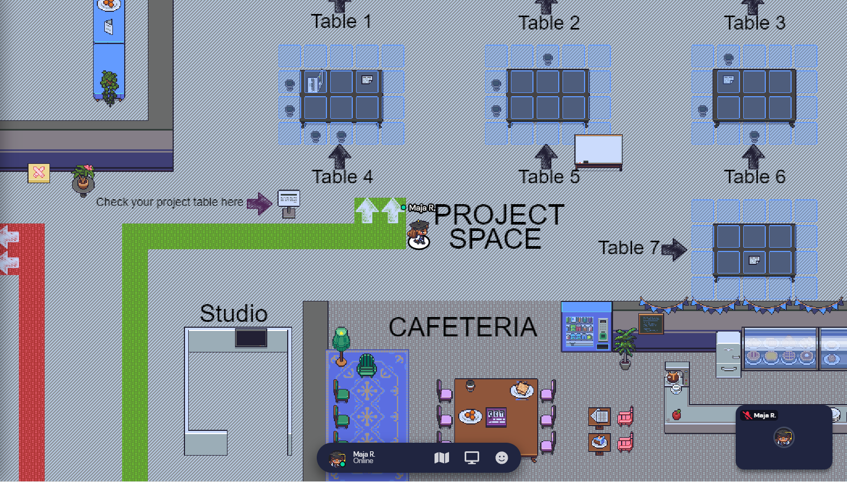
Execution: Kick-off programme
What did you like about this course/project? | Course structure and management;

Slide 16

Execution: Lectures
How difficult was it for you to understand the content of the lectures? I understood most lectures and learned some new insights I understood most lectures but learned only little new insights I struggled to understand some lectures but learned some new insights I struggled to understand some lectures and learned only little new insights I missed most lectures | 22.2% 22.2% 55.6% 0% 0%
What would you like to improve in this course/project? additional comments | Missing connection lectures and project; Have discussions after the lectures or team debates; Guest lectures did not always fit the rest of the course. Perhaps add suggested reading for guest lectures. more lectures from industry UN-DTU partnership for possible presentations Lectures were separate from all other things in the course If the point is to experience those lectures are difficult, the point can be made in 1 or 2 mornings. It would be nice to have lectures that explicitly contribute to the CBL challenges Nice to put lectures in framework / context If the point is to get an overview of technologies, the lectures has to change. Many lectures familiar to the students (in particular TU/e SET students Breaks in between lectures

Slide 17
Execution: Lectures
How difficult was it for you to understand the content of the lectures? I understood most lectures and learned some new insights I understood most lectures but learned only little new insights I struggled to understand some lectures but learned some new insights I struggled to understand some lectures and learned only little new insights I missed most lectures | 22.2% 22.2% 55.6% 0% 0%
What did you like about this course/project? Would you prefer the alteration of the lectures to adjust for the CBL project? Or would you prefer to have a clear split? | Broad spectrum of lectures; Interesting and relevant research topics; The two different components (symposium and project); Very good up to date lectures from top researchers. Rather a clear split

Slide 18
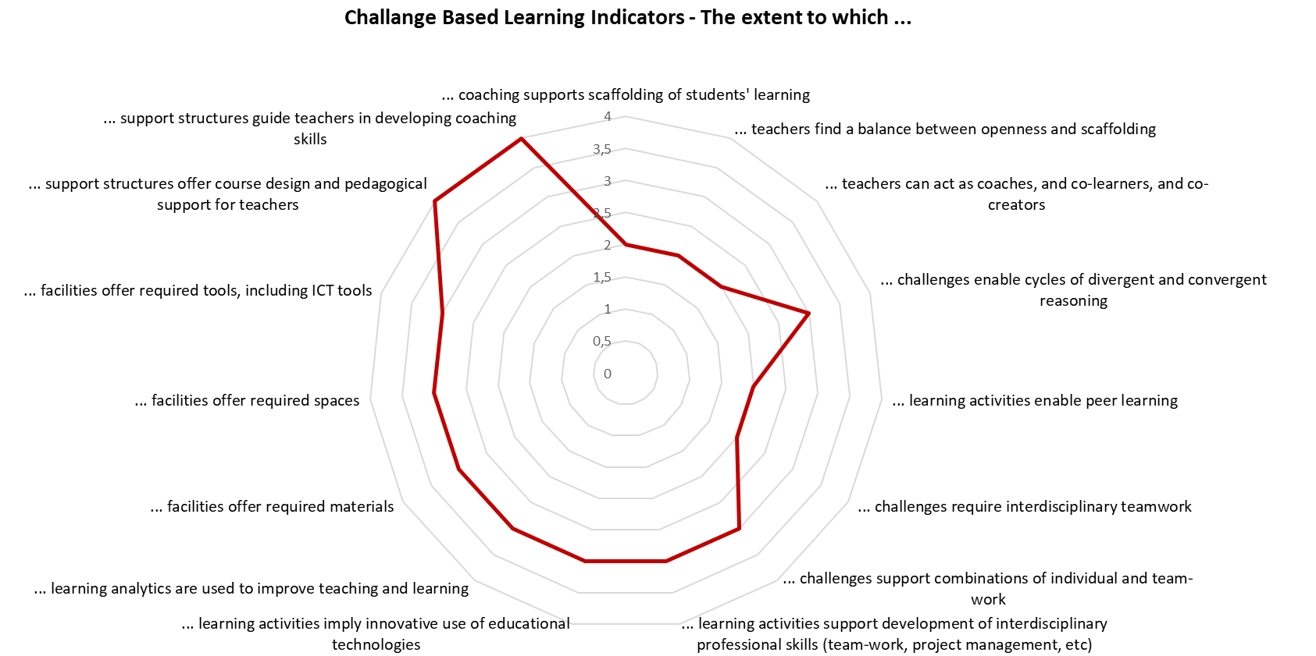
Execution: CBL-project

Slide 19
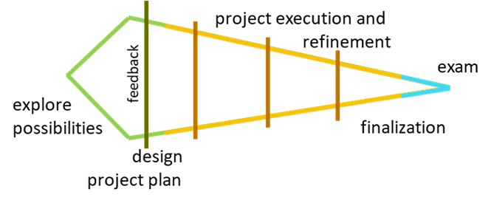
Execution: CBL-project
How much did the CBL-project contribute to achieving the goals of this project? (1= the CBL component was unnecessary; 5= the CBL component was essential) | 4.8 (0.4)
What did you like about this course/project? | The two different components (symposium and project); The freedom in the project; Choosing your subject
What would you like to improve in this course/project? | Missing connection lectures and project; More involvement with other group projects;.

Slide 20

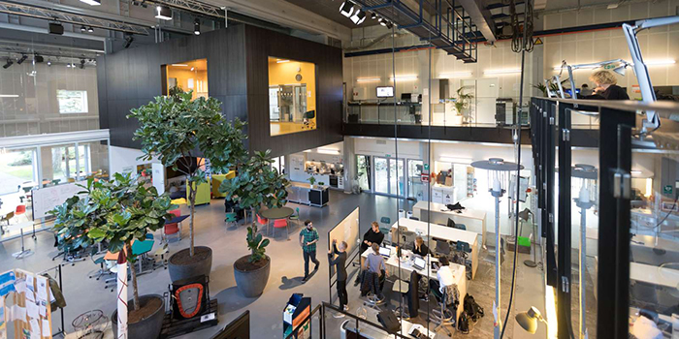
Execution: Live experience
How much did the in-person meeting add value to your learning experience? (1=unnecessary; 5=essential) | 4.4 (1.3)
What did you like about this course/project? | Being able to travel to DTU; International collaboration;
What would you like to improve in this course/project? | Learning more about renewable energy outside university research in Denmark; Add a social event the night before the first day at DTU;

Slide 21
Teachers evaluation
Overall how do you rate the course? Overall rating: 7/10
It seems that the students were very happy with the course.
The participation was a bit limited and that reduced the overall score for me.
Generally, the teachers are convinced by the objective of the course, and would like to contribute to it again.
Do you believe it does add value for the students?
My impression is that the students learned a lot. Mostly on how to work together and how to split the tasks. We might want to consider if we need to change or update the projects.
Yes, although I think the value is more in competences than knowledge. I feel that things like project management, understanding how information is usually offered, cooperation, creating/finding a storyline, matching your supervisors/boss expectations etc were already quite well developed though we could try to give more singular advise as supervisors. On the content I still think we should think more carefully about what we want them to know/have learned after the course. It can be more elegant/structured – is my personal opinion. But this usually takes time to develop.
My impression was that the student learned from both the lectures and project. However, they need support with to gain more from the lectures
What items were particularly important to you?
I liked the discussions. We need to rethink how to engage the students during the lectures.
I did enjoy the supervision of group work. I missed the collaboration with the other teachers and activities for the whole group.
I liked the integration of the PhD summer school.

Slide 22
Teachers evaluation
Where do you see room for improvements/ need for discussion?
The lectures need to be more aligned with the projects.
We need to consider how to engage with the students during the lectures.
More student participation. More discussions.
More cross-groups discussions.
Students want to see the output of other groups projects.
Too many assignments.
Rethink the grading.
we have to think about what we grade and how we grade. I would suggest to keep the feedback/elaborate on the feedback instead of giving ‘partial grades’. I did like the fact that each teacher had a responsibility for correcting a particular assignment. This way you prevent grading differences between teachers within an assignment.
Assist in the comprehension of the lectures
Communicate connection and divergence between lectures and project
Facilitate cross-group communication
What feedback on the course did the students share with you?
More international context (also from developing countries).
More EuroTeQ university involved.
More industrial involvement.
More interactive presentations.

Slide 23
Future plans:
Course management:
Funding
collab. PhD Summer school
inviting other universities
Invite industrial partners
Course content – addressing the feedback
+ recap Q&A for the lectures
+ peer-feedback for interim decision
+ peer-feedback before final project presentation
Quiz (replacement by multiple choice?)
Project management report (integration into group work & peer-feedback)
Clear communication
  split between CBL-project and lectures
  Technological focus
How much would you be willing to contribute to the travel expenses (3 days incl. flight and stay) in case no other funding source is available? 0 EUR/DDK Up to 200 EUR Up to 400 EUR Up to 600 EUR | 11.1% 66.7% 11.1% 11.1%

Slide 24
New course structure addressing student and teacher feedback
Time | Monday | Tuesday | Wednesday | Thurday | Friday
8-9
9-10
10-11
11-12
12-13
13-14
14-15
15-16
16-17
17-18
18-19
19-20
Time | Monday | Tuesday | Wednesday | Thurday | Friday
8-9
9-10
10-11
11-12
12-13
13-14
14-15
15-16
16-17
17-18
18-19
19-20
Kick-off
programme
lectures
(online)
Mini-lecture
+ discussion
Assessment 1
(project plan)
feedback
lecture
discussion
project-
planning
peer-
feedback
lecture
discussion
project-
execution
feedback
Assessment lectures
Time | Monday | Tuesday | Wednesday | Thurday | Friday
8-9
9-10
10-11
11-12
12-13
13-14
14-15
15-16
16-17
17-18
18-19
19-20
finalization
Assessment (video+presentation)
transit
to DTU
Reflection
peer-
feedback
social

Slide 25
Take-aways for focus topics
  Balancing and integrating individual (deep) learning and team-based learning in a blended CBL course for the MSc level in an interdisciplinary context
  individual learning was facilitated by a discussions on individual learning goals and a reflection session
  Overall, we got the impression that individual and group learning went hand in hand
  Attendance of students of different level and different engagement was a challenge
  ➔ majority of the students benefited; some individuals missed out
  Coaching strategies research-based challenges
  Hybrid teachers help to convey a realistic view on industrial projects
  Gather-town as location for group formation was positively received
  Guidance on the group development was appreciated
  Reflection on project management was appreciated
  Cross-country communication
  Lecture on international communication was well received
  International setting was appreciated.
  The student preferred physical visit over an entire online course (with a more international community)
  They would appreciate a wider range of collaborations
  Online component was adequate
  international course management
  Grading causes a challenge
  Funding needs to be found
  Matching of teaching philosophy (e.g. BSc student attending, the use of answer models/ rubrics, reflections etc.)

