Slide 1
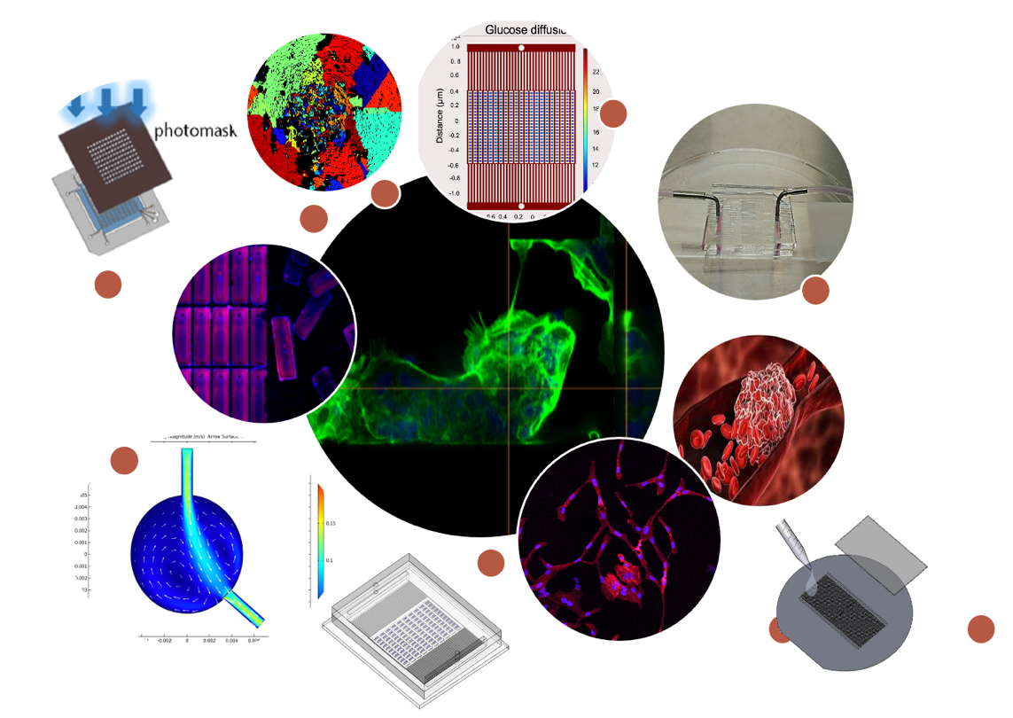
8P380 Lab on a chip Microdevices
Burcu Gumuscu & Lanhui Li

Slide 2
8P380 Lab on a chip Microdevices
Characteristics
CBL
The brand-new Lab on a Chip Microdevices course is supported by challenge-based learning
Collaborate
Collaboration between BME and ME to boost the knowledge transfer between the departments at the student level
Capacity
Hybrid
Available for both BME and ME students both B.Sc. (3rd year) and M.Sc.
The course capacity is max 60 students in a lab setting

Slide 3
Course structure
8P380 Lab on a chip Microdevices Course
Challenge-Based Learning
- Challenges on broad topics covering microfabrication to cells-on chip, droplet microfluidics to mass transport and sensing
Hands-on lab sessions (project proposal by students)
  Collaboration with industry
  Real-life problem solving
  Microdevice design & fabrication by students
  Testing and characterization
  Data analysis

Slide 4
Learning objectives
8P380 Lab on a chip Microdevices Course
To explain the theoretical background underlying the challenge topics.
To describe the lab-on-a-chip concept and how it is applied in real-life problems.
To identify current state-of-the-art methods and their drawbacks used to solve one specific real-life problem.
To identify the microfabrication skills necessary for the production and testing of microfluidic devices.
To apply effective communication skills individually when engaging with the team and the stakeholders.

Slide 5
Course flow
Learning
7 CBL challenges on different lab on chip topics (week by week)
Presentation
& Feedback
Student presentations on the challenge of the previous week
Teachers & TAs give feedback and do assessment
Practice
Maximum 2 groups can register for the same project
Presentation
& Assessment
All students work in groups on the same challenge
Running 7 weeks in parallel with the CBL challenges
5 projects on different real-life problems
2 weeks proposal + 5 weeks lab work
Written project plan (design, simulation, prototype),
Final presentation on the project
8P380 Lab on a chip Microdevices

Slide 6
8P380 Lab on a chip Microdevices
Study load
Study load: 140 hours in total
7 weeks of CBL (theory work)
7 weeks of project proposal and implementation (practical work)
Additional efforts:
- Study theory: 30 hours
- Project proposal: 10 hours
- Data analysis: 25 hours
- Presentation: 10 hours
- Workshop: 2 hours

Slide 7
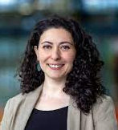

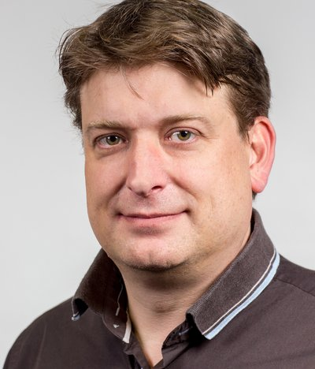
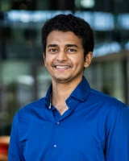
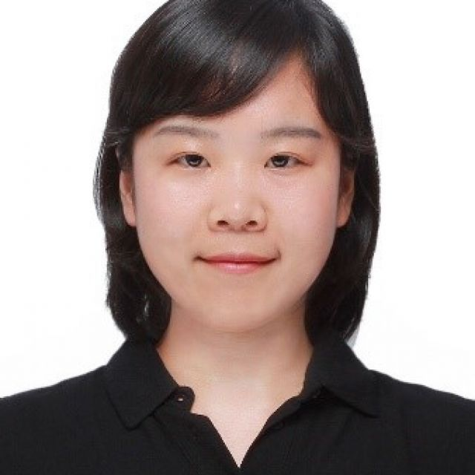
8P380/4UM10
Burcu Gumuscu
Lanhui Li
Jaap den Toonder
Kalpit Bakal
Hans Wyss
8P380 Lab on a chip Microdevices Course
Interdisciplinary teacher team

