Slide 1
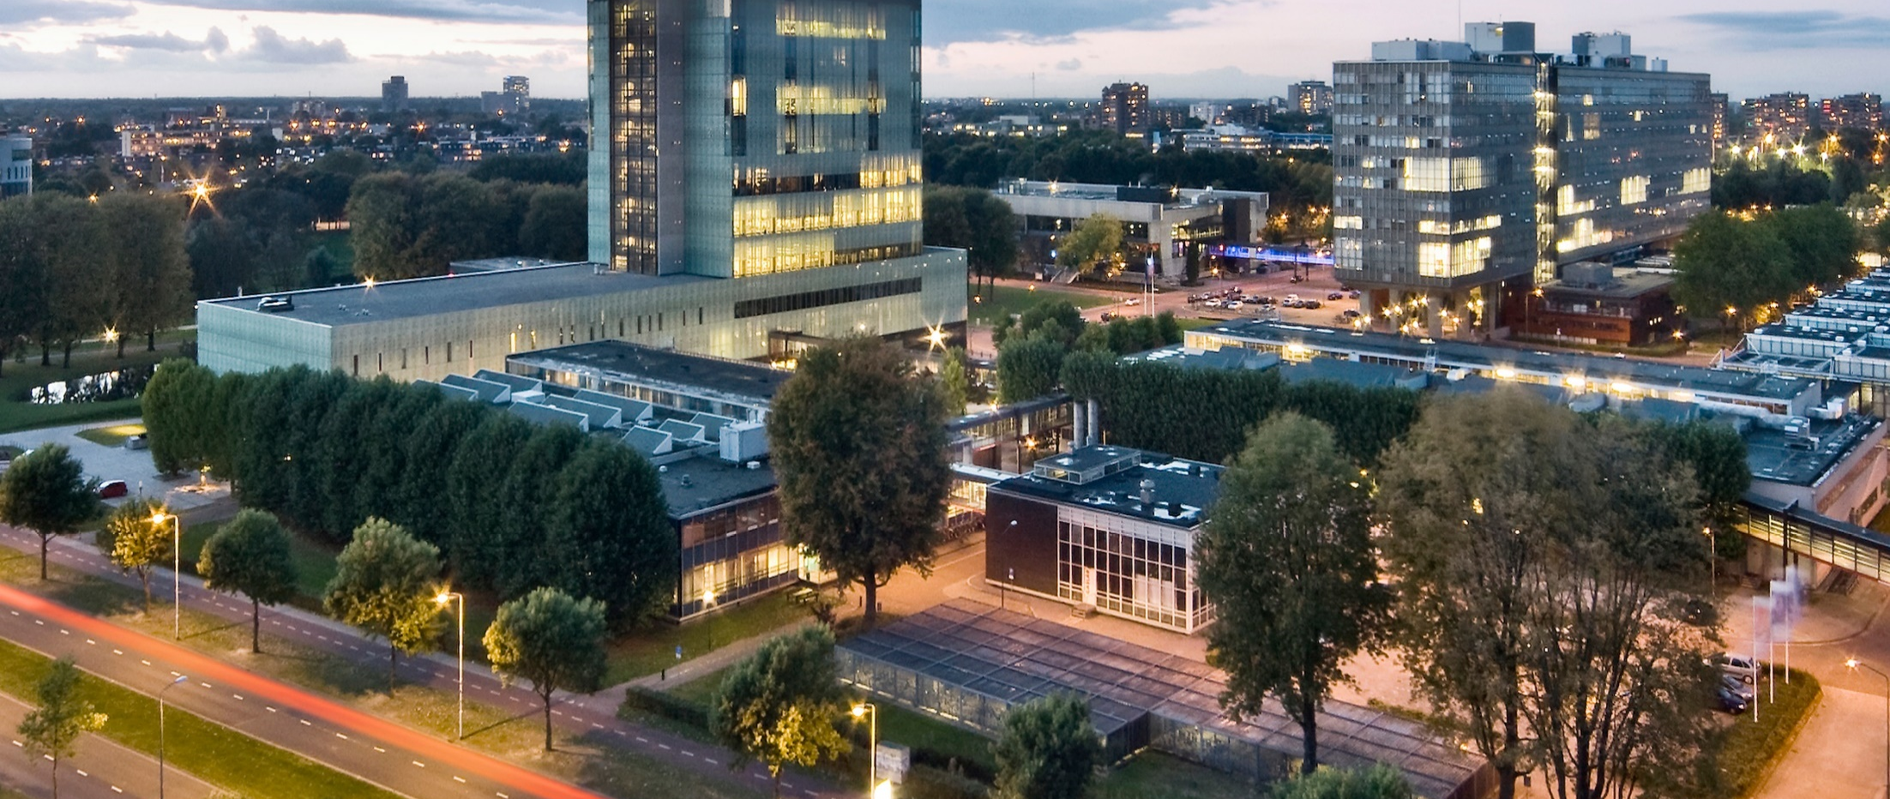
Engineering Design – Introduction
Tutor training, Sep 2 2021
Bart van Esch

Slide 2
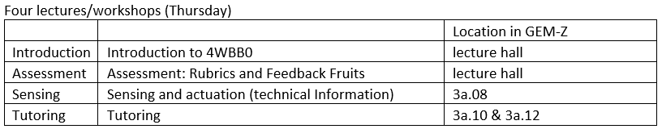
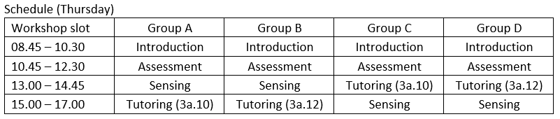
Today's schedule
Tutor training

Slide 3

Student evaluation in 2020-2021
Positive
- multidisciplinary / group work
freedom
learn about design process
tangible product
personal contribution
Negative
no connection with major
not everyone participates
Engineering Design

Slide 4
Engineering Design
2021-2022
What remains
- multidisciplinary group work
going through generic design process
tangible product
organization
CBL modules (former "special topics")
group member evaluation (FeedbackFruits)
The changes
CBL modules not mandatory
requirement: individual contribution
more emphasis on challenge/innovation

Slide 5

Design question
Develop an aid for personal, in-house use, for people with an impairment or disability, or for elderly people allowing them to live in their private homes (for a longer period of time)
Freedom to choose a design goal:
disability/impairment
type of user
in-house activity
type of aid
Aid should be autonomous or interactive
Integrated sensor(s) and actuator(s)

Slide 6
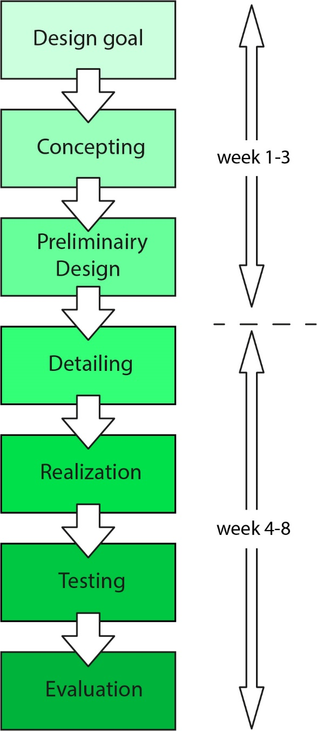
Some keywords
Design
- innovative design, challenging
- user-friendly, esthetic, desirable
Process
- full design process
- planning and organization
- budget control
Realization
- feasible, within budget
- functional
- autonomous or interactive

Slide 7
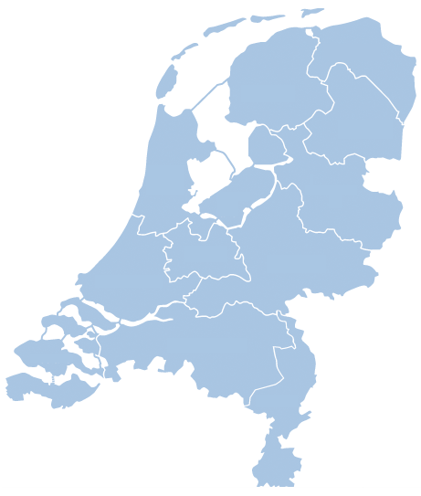
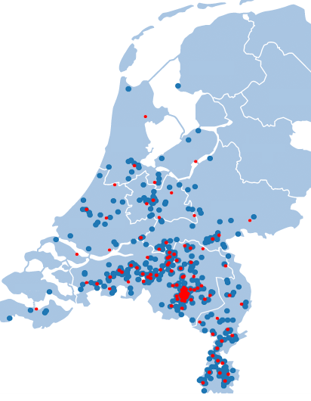
Organization
1693 students, 288 multi-disciplinary groups of 6 students
supervision by 18 teachers and 72 tutors (4 replacements)
4 student groups per tutor
4 tutors per teacher
group formation based on postcode
group meetings close to home
no need for public transport or
workspace at TU/e
solution for building and testing
student
group

Slide 8
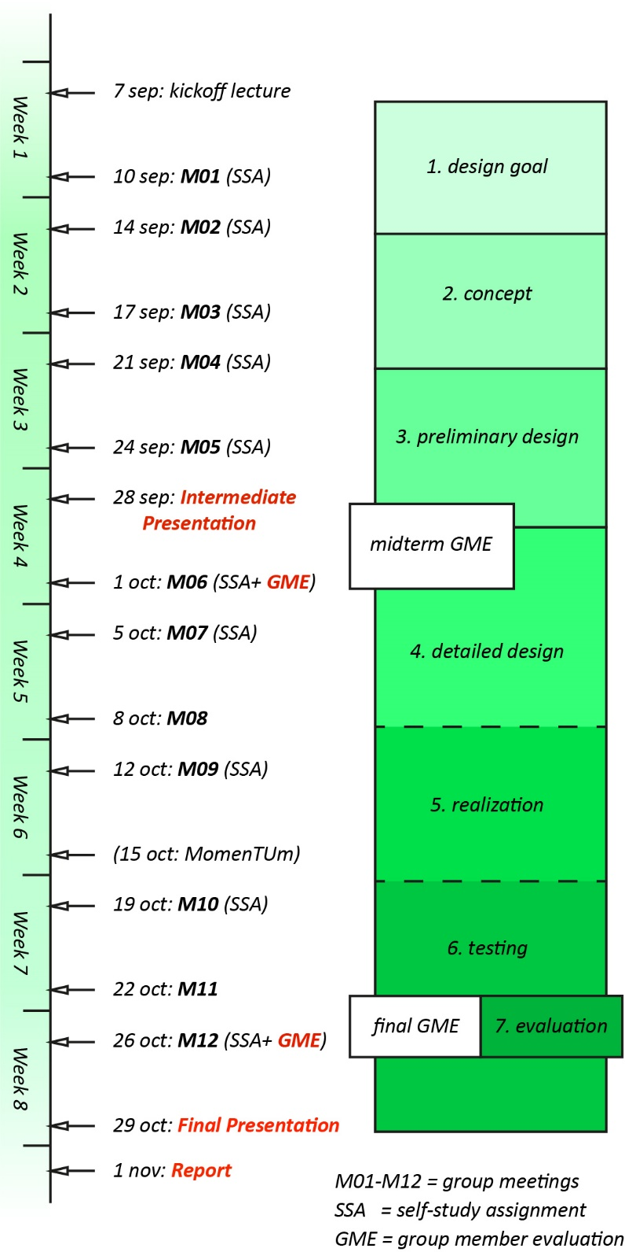
Organization
kickoff lecture
  Panopto webcast (Canvas)
12x group meeting
  10x SSA
2x presentation
2x group member evaluation (GME)
  peer and self-assessment
  FeedbackFruits
report

Slide 9
Tasks of a tutor
tutoring of 4 groups:
motivate, encourage, criticize, reflect, evaluate,
… but not steer
monitor progress, enforce decisions if necessary
individual assessment
two group meetings a week
assessment of SSA’s the evening before
reporting absences to group meetings
weekly meeting with teacher: group progress, evaluation students
suggestion for midterm and final (individual) assessment
support during IP and FP (member of jury)
assistance in assessment of reports

Slide 10
Assessment
Individual assessment
based on
  group meetings
  SSA's
  individual contribution
0% : midterm assessment (Oct 1)
30% : final assessment (Oct 26)
grade ≥ 6.0 to pass
grade 5.0 – 5.9 retake
Group assessment
10% : interm. presentation (IP)
20% : final presentation (FP)
40% : report

Slide 11
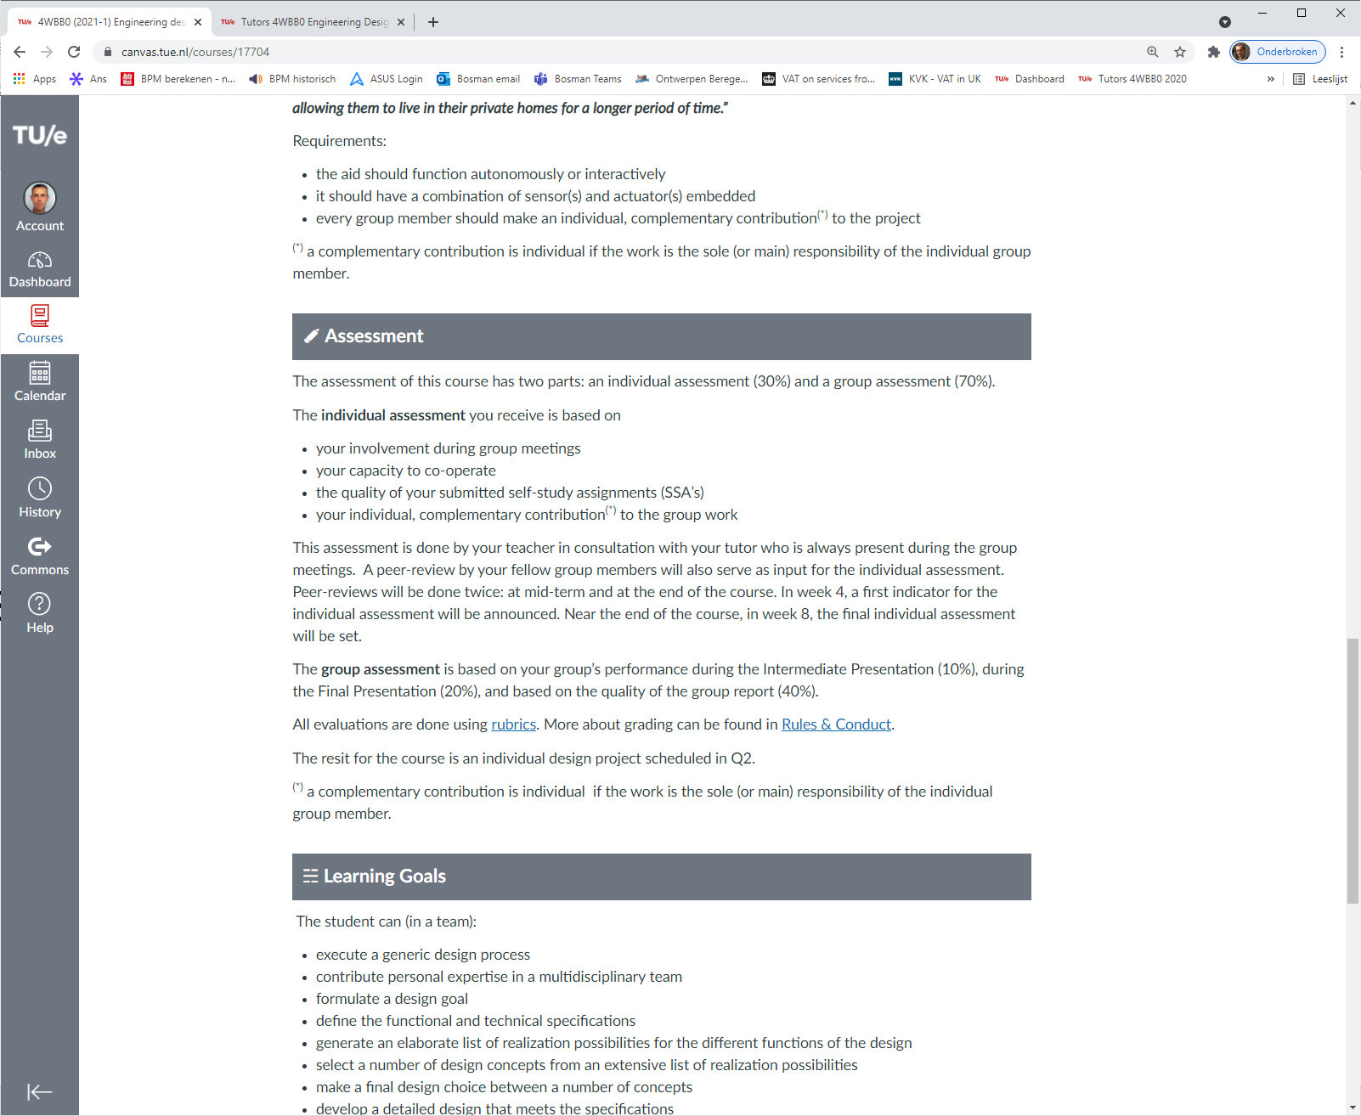
Assessment
Individual assessment
based on
  group meetings
  SSA's
  individual contribution
0% : midterm assessment (Oct 1)
30% : final assessment (Oct 26)
grade ≥ 6.0 to pass
grade 5.0 – 5.9 retake
Group assessment
10% : interm. presentation (IP)
20% : final presentation (FP)
40% : report

Slide 12
Assessment
Individual assessment
based on
  group meetings
  SSA's
  individual contribution
0% : midterm assessment (Oct 1)
30% : final assessment (Oct 26)
grade ≥ 6.0 to pass
grade 5.0 – 5.9 retake
Group assessment
10% : interm. presentation (IP)
20% : final presentation (FP)
40% : report
rubric
rubrics (every meeting)
midterm SSA / final SSA
rubric
rubric
rubric

Slide 13
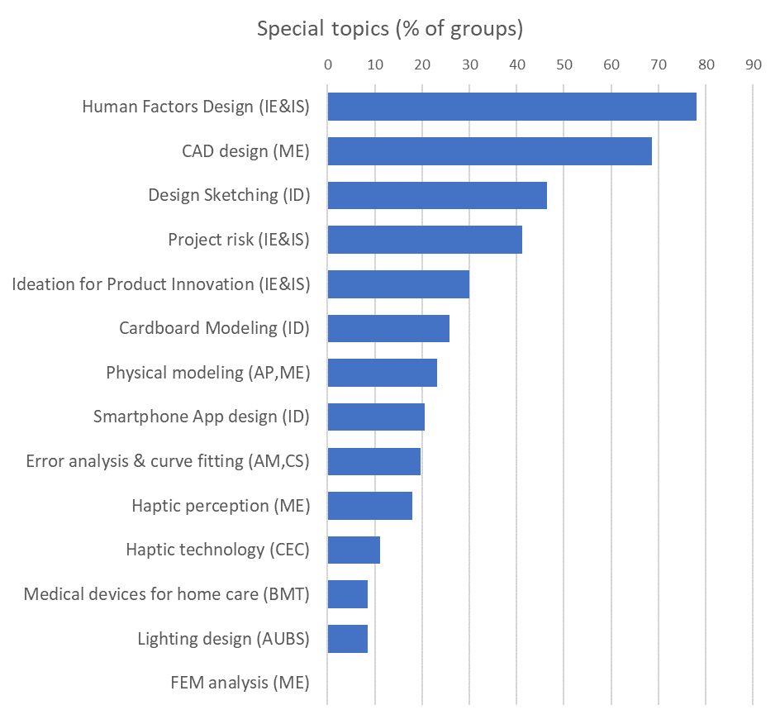
CBL modules
List of topics
- offered as educational modules
(± 1 ECTS)
topics relate to specific majors
meant to engage all group members
possibility for 'individual contribution'
optional
other contributions allowed
group obligation
+ Basics of electronics
+ Sensing & computing
+ Story board/video prototyping

Slide 14
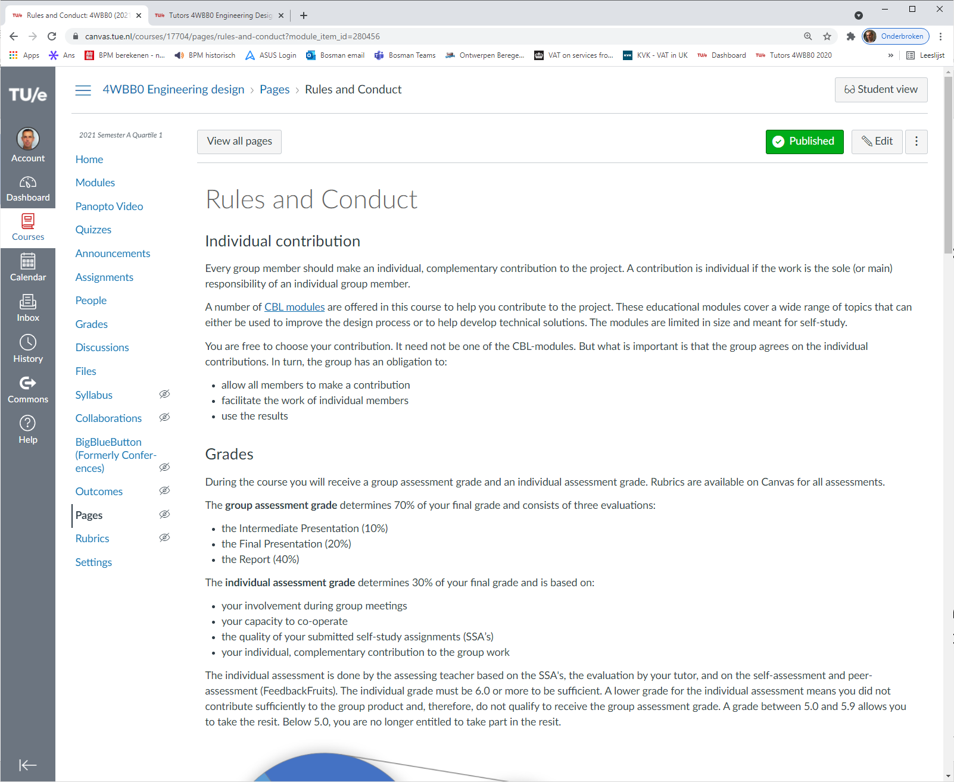




CBL modules
List of topics
- offered as educational modules
(± 1 ECTS)
topics relate to specific majors
meant to engage all group members
possibility for 'individual contribution'
optional
other contributions allowed
group obligation
+ Basics of electronics
+ Sensing & computing
+ Story board/video prototyping

Slide 15
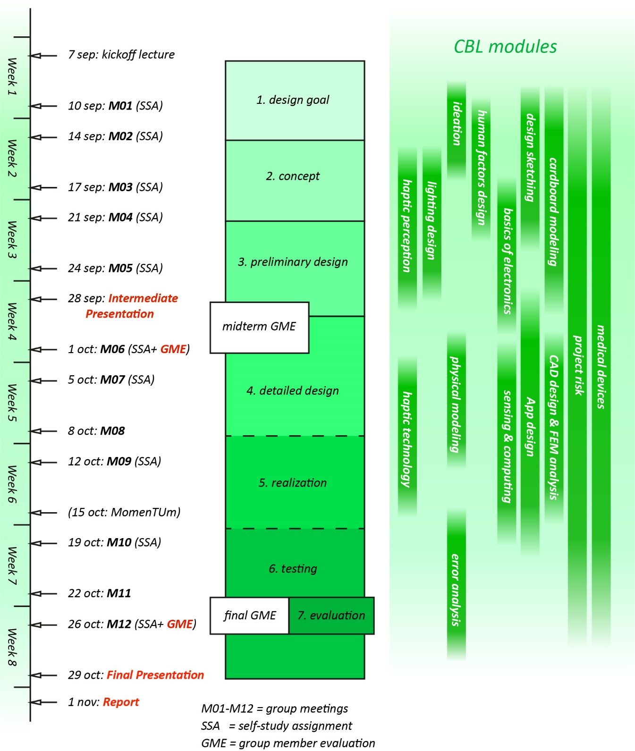
CBL modules
List of topics
- offered as educational modules
(± 1 ECTS)
topics relate to specific majors
meant to engage all group members
possibility for 'individual contribution'
optional
other contributions allowed
group obligation
note the time schedule !!

Slide 16
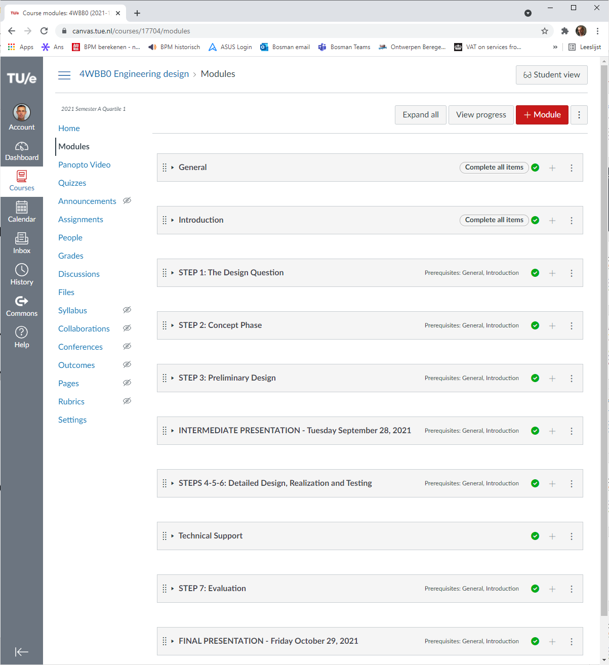
Canvas
manuals integrated in Canvas
user manual
technical manual
chronological order – steps 1-7
info in a timely manner
easy to find
dynamic platform
changes easy to communicate
up-to-date

Slide 17
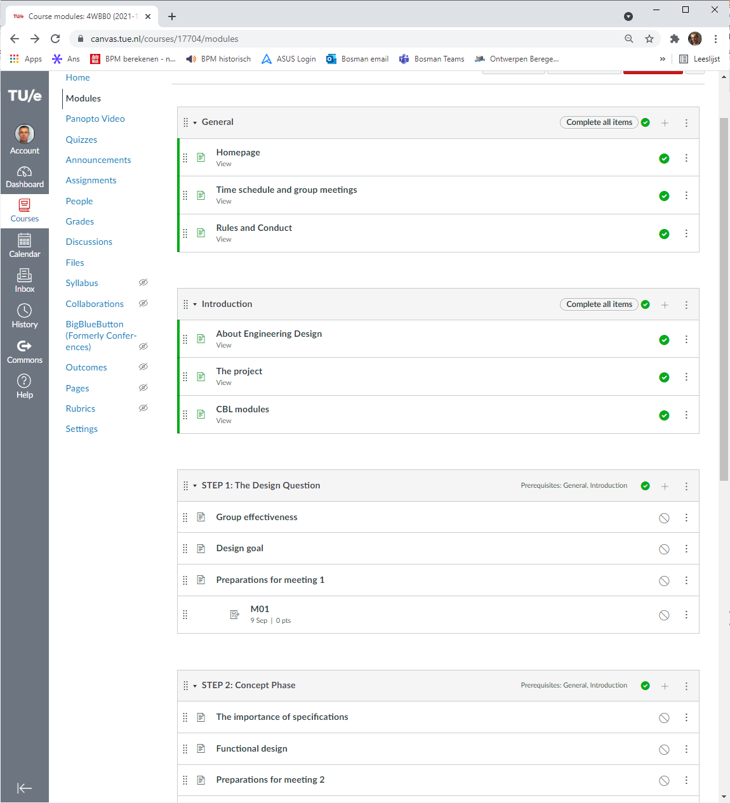
Canvas
manuals integrated in Canvas
user manual
technical manual
chronological order – steps 1-7
info in a timely manner
easy to find
dynamic platform
changes easy to communicate
up-to-date

Slide 18

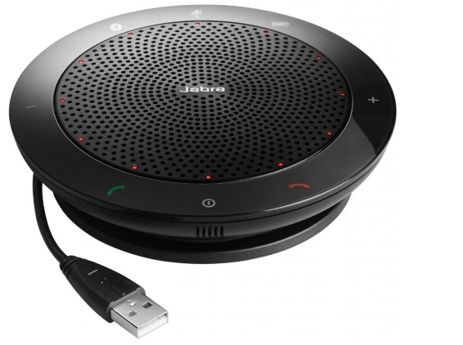
Absenses
Relaxed policy on presence to meetings
consequence of Covid-19 in 2020
valid reasons for absence:
illness, quarantine, issues with public transport
no reason for "incomplete" grade
group responsibility peer-review in FeedbackFruits
alternative: online presence in hybrid meeting
all tutors receive a Jabra
speaker/microphone
mute mics/speakers
of all other laptops!
absence noted by tutor reported to course organization

Slide 19
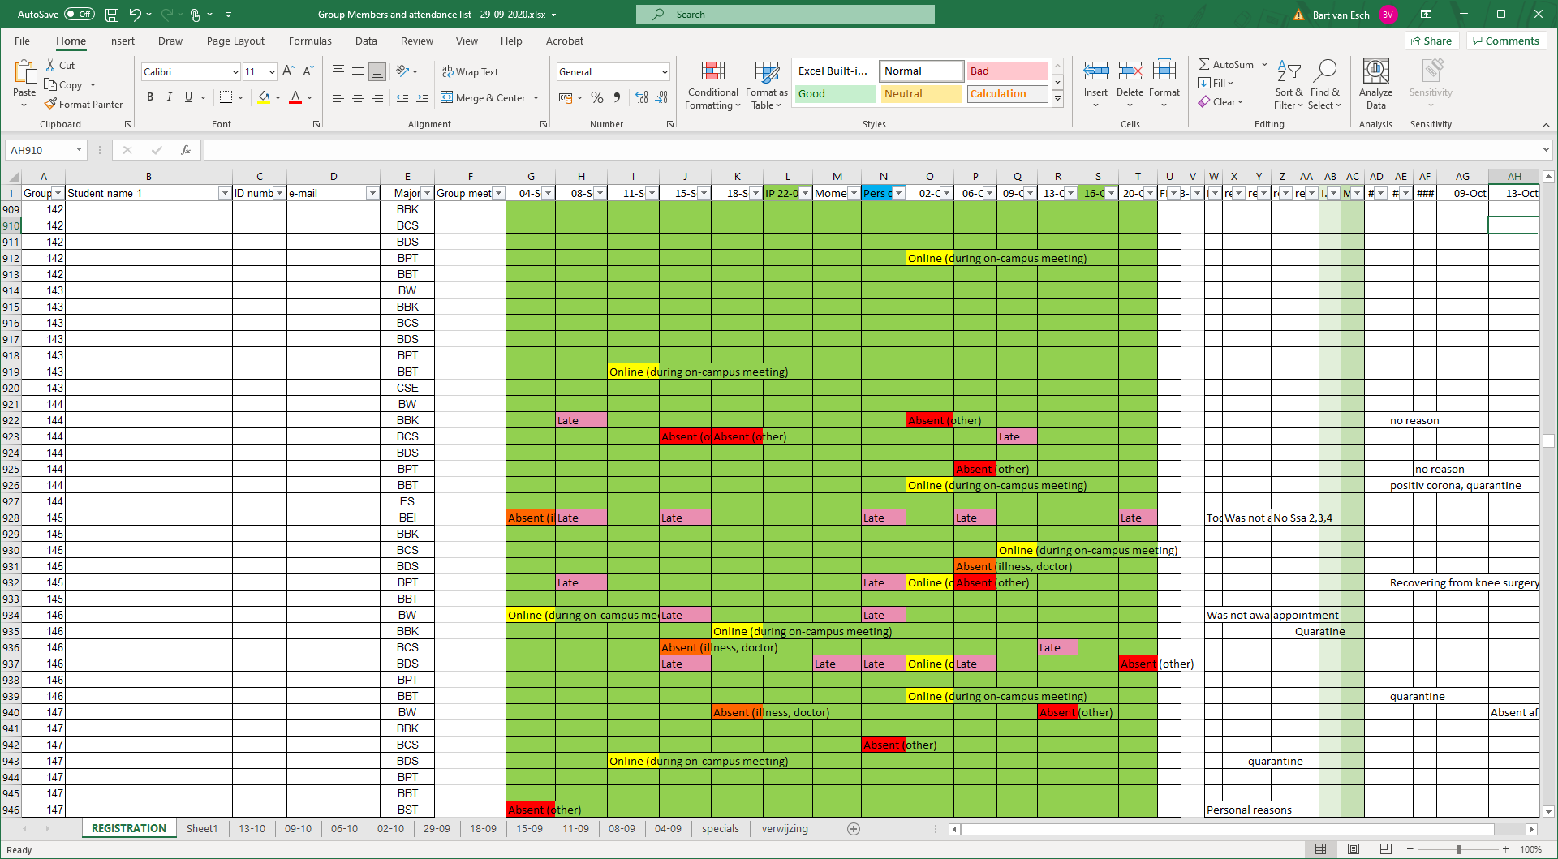
Absenses

Slide 20



Polo shirts
for all TA's
select model and size a.s.a.p.
(link to MS form on Tutor-4WBB0 Canvas)
wear them during intermediate
and final presentations, and
workshop supervision

Slide 21
Teachers
Core team

